Slide 1

Energy-Efficient Neuromorphic Computing
MS Project: Mid Term Presentation
Khritish Kumar Behera 17125
Mail: khritish17@iiserb.ac.in
Indian Institute of Science Education and Research [IISER] Bhopal
Advisor: Dr. Kuntal Roy
Mail: kuntal@iiserb.ac.in
Date: 10-03-2022

Slide 2
Content
Recap
Motivation
Artificial neural network
Character recognition model
Spintronics
Magnetic anisotropy
Magnetostriction
Perpendicular anisotropy
Giant Magneto-Resistance
Tunneling Magneto-Resistance
Neural network using spintronics
Multiferroic composites
Proposed device
Experimental
LabView
Ferromagnetic Resonance
Lock-in amplifier
LabView measurement automation
Future Plan

Slide 3
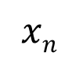
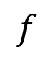
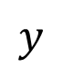
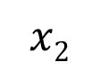
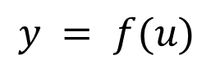
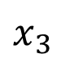
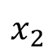
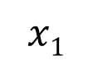
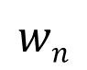

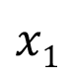
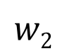
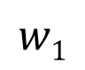
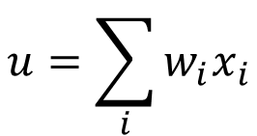
Energy-Efficient Neuromorphic Computing
Neuromorphic Computing is usually performed on traditional transistor based devices
$$u=\sum_{i}{w_{i}x_{i}}$$
$$x1$$
$$w1$$
$$y = f(u)$$
$$x2$$
$$w2$$
$$Σ$$
.
.
.
$$wn$$
Spintronic devices can be more energy-efficient than traditional transistors
$$f$$
$$xn$$
$$y$$
Piezoelectric
$$x1$$
Spintronic devices encapsulates
Weight, Sum and Threshold function
$$x_{2}$$
$$x_{3}$$
Neuron
Read
Insulator
Magnetostrictive
Write
Non-Boolean Computing

Slide 4
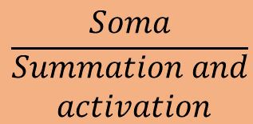
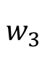
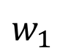

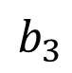
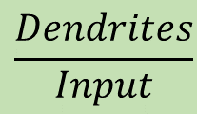
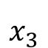
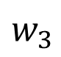
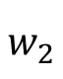
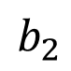
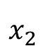
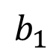
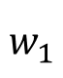
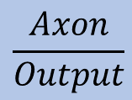
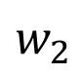
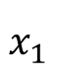
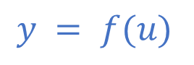
Artificial Neural Network (ANN)
$$w_{1}$$
$$b_{1}$$
$$\frac{Dendrites}{Input}$$
$$w_{2}$$
$$w_{1}$$
$$b_{2}$$
$$x_{1}$$
b
$$w_{3}$$
$$\frac{Soma}{\begin{aligned}Summation and \\ activation\end{aligned}}$$
$$w_{2}$$
$$x_{2}$$
$$Σ$$
$$b_{3}$$
$$w_{3}$$
$$x_{3}$$
Input layer
Hidden layer
Output layer
$$\frac{Axon}{Output}$$
$$y = f(u)$$
System of interconnected neurons
ANN Architecture
Output of a neuron, connected to all other neurons in the next layer
Three layers: Input, Hidden and Output layers
Weights and biases are the optimizing parameters

Slide 5
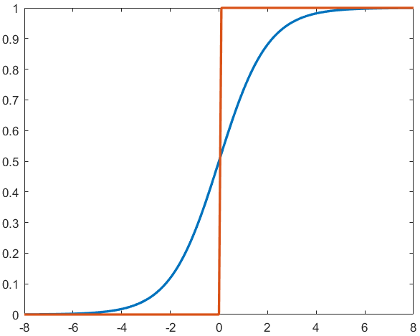
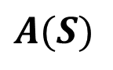
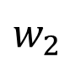
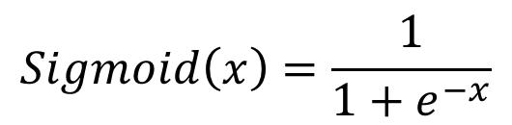

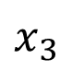

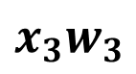
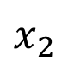
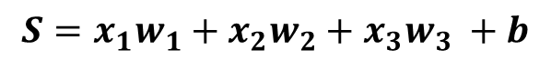
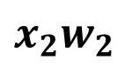
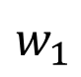
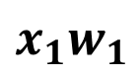
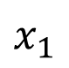
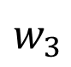
ANN: Sequential Process
Summation
Weight, strength of the edge
$$w_{1}$$
$$x_{1}$$
b
$$x_{1}w_{1}$$
b
$$w_{2}$$
$$x_{2}$$
$$Σ$$
$$x_{2}w_{2}$$
$$Σ$$
$$S=x_{1}w_{1}+x_{2}w_{2}+x_{3}w_{3} +b$$
$$w_{3}$$
$$x_{3}$$
$$x_{3}w_{3}$$
Bias, sets the activation function
$$Sigmoid\left(x\right)=\frac{1}{1+e^{−x}}$$
Activation
$$A(S)$$
Inspired from biological neuron
Non-linear function

Slide 6
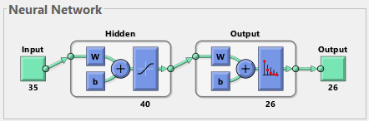
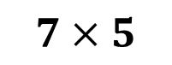
Artificial Neural Network: Neural Architecture
$$7×5$$
Input
35 (7x5)-bit word of the test character
Output
26-bit word suggesting the character
Input
A: 01110 10001 10001 11111
10001 10001 10001
Output
A: 10000000000000000000000000
B: 01000000000000000000000000

Slide 7
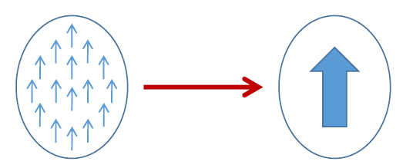
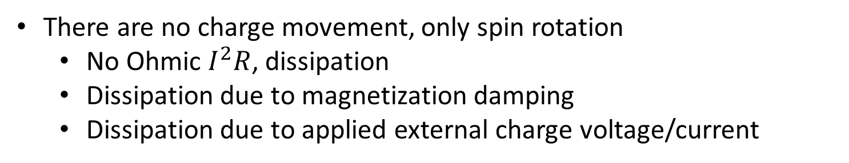

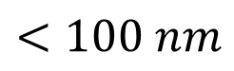
Spintronics: Spin-Electronics
UP
DOWN
0
1
Spin
Bits
Spin
$$e^{−}$$
Charge
Electron
Spintronic devices, advantages over transistor
non-volatile
endurable
There are no charge movement, only spin rotation
No Ohmic $I^{2}R$, dissipation
Dissipation due to magnetization damping
Dissipation due to applied external charge voltage/current
Electron Beam Lithography
$$<100 nm$$

Slide 8
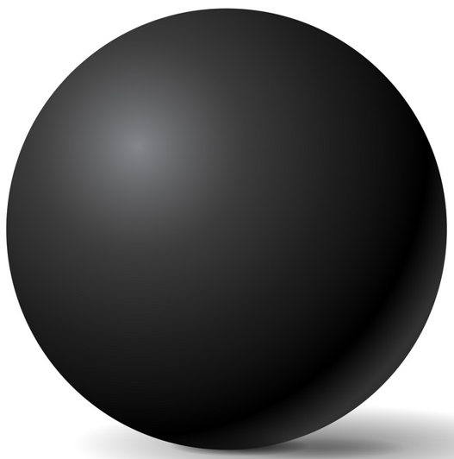
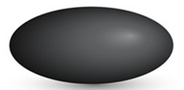


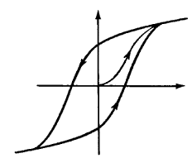










Magnetic Anisotropy
CoFeB
Sphere
Ellipsoid
Elliptical Cylinder
No anisotropy
Difficult to fabricate
In-plane
Shape anisotropy
x
Magnetization
30-80 KT at 300 K
$$E=\frac{1}{2}Ωμ_{0}M_{s}H_{k}\sin^{2}{θ}$$
$$ϕ$$
$$θ$$
$$E barrier$$
z
y
$$φ=±90^{o}$$
$H_{k}:$Coercive field
M
$Ω:$ Volume
$E_{barrier}=40$ KT,
10 years data retention time
H
$$θ={180}^{o}$$
$$θ=0^{o}$$
H_{k}

Slide 9







Magneto-elastic anisotropy
Magnetostrictive Materials: Certain ferromagnetic specimen changes its shape (strain$ε$:$∂l/l$) during the process of magnetization
Magnetic Anisotropy
Stress Anisotropy
$$σ:Stress$$
$$Ω:Volume$$
$$\frac{3}{2}λ σ Ω \cos^{2}θ$$
$$σ=Yε=Yd\frac{V}{t}$$
Cobalt:
$$\frac{3}{2}λ=−30×{10}^{−6}$$
FeGa:
$$\frac{3}{2}λ=150×{10}^{−6}$$
$λ:$ Magnetostriction Co-efficient

Slide 10
















Perpendicular Anisotropy
CoCrPt
z
z
Magnetization
direction
Easy axis:
$$θ=0^{o},{180}^{o}$$
$$θ= 0^{o}$$
Bulk
$$θ$$
Hard axis:
$$θ={90}^{o}$$
y
MgO
y
$$φ$$
CoFeB
x
x
$$θ={180}^{o}$$
t_{CoFeB}<1.3 nm
Magnet’s plane: $φ =±90^{o}$
Interface
$$E_{shape}\left(θ,φ\right)=\frac{1}{2}{ μ}_{0 }M_{s }^{2}Ω{ N}_{d}\left(θ,φ\right)$$
$$N_{d−xx}+N_{d_{−}yy}+N_{d−zz}=1$$
$$N_{d}\left(θ,φ\right)=N_{d−xx}\sin^{2}{θ}\cos^{2}{φ}+{N_{d−yy}\sin^{2}{θ}sin}^{2}{φ}+{N_{d−zz} cos}^{2}{θ}$$
$$E_{shape}\left(θ,φ\right)=\frac{1}{2}μ_{0}M_{s}[H_{k}+H_{d}\cos^{2}{φ]Ω\sin^{2}{θ}}$$
$$HPMA=H_{k}+H_{interface}$$
Circular cross-section
$$H_{d}=\left(N_{d_{−}xx}−N_{d_{−}yy}\right)M_{s}$$
$$=0$$
$$E_{PMA}\left(θ\right)=\frac{1}{2}{ μ}_{0 }M_{s}{ H}_{PMA} Ω\sin^{2}{θ}$$
$$H_{k}=\left(N_{d_{−}yy}−N_{d_{−}zz}\right)M_{s}$$
IISER Bhopal
Notes:
There are 2 kind of possibilities: Bulk anisotropy and Interface anisotropy
Where Nd(teta, phi) comes form -> spherical coordinate system
What is the requirement for perpendicular anisotropy

Slide 11







Perpendicular interface anisotropy
In-plane
sample
Out-of-plane
sample
z
$$N_{d_{−}zz}≫N_{d_{−}yy}≃1$$
$$k_{i}=1.3 mJ/m^{2}$$
MgO
Bulk
Interfacial anisotropy
$$tCoFeB<1.3 nm$$
$$\frac{K}{Ω}=\frac{1}{2}{ μ}_{0}M_{s}^{2}\left(N_{d_{−}yy}−N_{d_{−}zz}\right)+\frac{k_{i}}{tCoFeB}$$
y
CoFeB
x
Interface
$$\frac{K}{Ω}tCoFeB=−\left(\frac{1}{2}{ μ}_{0}M_{s}^{2}\right)tCoFeB+k_{i}$$
Ikeda, S. et al. "A perpendicular-anisotropy CoFeB–MgO magnetic tunnel junction."
Nature Materials 9 (2010) 721-724

Slide 12






Giant Magneto-Resistance (GMR)
Giant Magneto-Resistance (GMR)
$$GMR=\frac{1−0.55}{0.55}×100≃80\%$$
$$\text{Fe}$$
$$\text{Cr}$$
$$\text{Fe}$$
1988
A. Fert, M.N Baibich et al., Phys. Rev. Lett. 61, 2472 (1988)
P. Grunberg, G. Binash et al., Phys. Rev. B 39, 4828 (1989)
$$GMR[\%]=\frac{R\left(0\right)−R(H)}{R(H)}=\frac{RAP−RP}{R_{P}}×100$$

Slide 13









Tunneling Magneto-Resistance (TMR)
Insulator
e.g., Al₂O₃, MgO
Conductance is proportional to the density of states
N_{L}↑, N_{R}↑, N_{L}↓, N_{R}↓
Left (L)
Right (R)
Left (L)
Right (R)
$$G^{↑↑}∝N_{L}^{↑}{ N}_{R}^{↑}$$
$$G^{↓↓}∝N_{L}^{↓}{ N}_{R}^{↓}$$
$$G^{↓↑}∝N_{L}^{↓}{ N}_{R}^{↑}$$
$$G^{↑↓}∝N_{L}^{↑}{ N}_{R}^{↓}$$
$$EF$$
$$TMR=\frac{GP−G_{AP}}{GAP}$$
Reported 1975 (prior to GMR)
TMR>500% using MgO spacer
$${GP=G}^{↑↑}+ G^{↓↓}$$
$${GAP=G}^{↓↑}+G^{↑↓}$$
Julliere, M. Tunneling between ferromagnetic film. Phys. Lett. A 54, 225-226 (1975)
Moodera, J. S. et al., Phys. Rev. Lett. 74, 3273 (1995)
Mathon, J. et al., Phys. Rev. B 63, 220403 (2001), Butler, W. et al., Phys. Rev. B 63, 054416 (2001)
Yuasa, S. et al., Nature Mater. 3, 868 (2004), Parkin, S. et al., Nature Mater. 3, 862-867 (2004)

Slide 14





Multiferroic Composites
Multiferroic Composite
Multiferroics
Room-temperature operation
Weak magnetoelectric coupling
Magnetostrictive
Piezoelectric
E
Strain
P
$$\boxed{α_{ME}=μ_{0}\frac{∂M}{∂σ}\frac{∂σ}{∂E}}$$
Piezoelectricity
Magnetoelectricity (intrinsic)
$$\boxed{α_{ME}=μ_{0}\frac{∂M}{∂E}}$$
$$ε$$
M
$$σ$$
H
Magnetostriction

Slide 15




Multiferroic composites Voltage vs stress anisotropy
V_{in}
$$ε_{piezo}=d_{piezo}×\left(\frac{V_{in}}{t_{piezo}}\right)$$
$$ε_{mag}≃ε_{piezo}$$
$$σ=Yε_{mag}$$
Magnetostrictive
FeGa
Piezoelectric
t_{piezo}
PMNPT
strain transfer
Choose piezoelectric layer with high de-coefficient
Y: Young’s modulus
Magnetostrictive layer
with high $λ_{s}Y$
$$d=3000 pm/V$$
$$Y=250×{10}^{9} Pa$$
$$t=100 nm$$
$$V=50 mV$$
Stress Anisotropy (for FeGa):
$\frac{3}{2}λ σ Ω \cos^{2}θ$
$=2.4×{10}^{−18} J$ (max.)

Slide 16

Proposed Device
Electric Potential to Piezoelectric
$$y$$
Piezoelectric
Stress anisotropy in Piezoelectric
x₁
x₂
x_{n}
.
.
Stress anisotropy in Magnetostrictive
TMR
Magnetic anisotropy in Magnetostrictive
Insulator
Magnetostrictive
Magnetization direction changes in TMR
The piezoelectric material
Serves the purpose of summation
The different dimension of blue pillars
Serves the purpose of weight
Generation of variable voltage

Slide 17

Automation in measurement: LabView
LabView
Graphical programming environment
Automated measurements, validation, and production test systems
Control and synchronize different devices from different companies
Centralized system for data acquisition
Flexibility in programming the devices

Slide 18


LabView Automation: Electromagnet
Creates a session with electromagnet’s controller for communication
Measures the magnetic field using the gauss probe
Terminates the session and stops further communication
Takes current as input, to set it in the electromagnet
PC with labview is connected to the controller
Gauss probe
The gauss probe and the electromagnet is also connected to the controller
Controller
Electromagnet

Slide 19


LabView Automation: RF Signal Generator
Creates a session with RF signal generator for communication
Configures the RF signal frequency
Configures the RF signal power level
Configures ON/OFF state of the signal generator
Terminates the session with RF signal generator
PC with labview is connected to the RF signal generator

Slide 20


LabView Automation: Spectrum Analyzer
Creates a session with spectrum analyzer for communicat-ion
Configures the spectrum analyzer
Fetch the trace from the device
Search position on trace to put marker
Retrieves data from the marker
Terminat-es the session with the device
PC with labview is connected to the Spectrum analyzer

Slide 21









Ferromagnetic Resonance
precession
$$\frac{ⅆM}{ⅆt}=−\left|γ\right| M×Heff− \frac{α\left|γ\right|}{M} M×M×Heff$$
damping
$$ω^{2}={\left|γ\right|}^{2}(H_{z}+\left(N_{yy}−N_{zz}\right)M)(H_{z}+\left(N_{xx}−N_{zz}\right)M)$$
In-plane FMR
$$ω=\left|γ\right| \sqrt{H_{z}\left(H_{z}+M\right)}$$
$$N_{xx}=N_{zz}=0, N_{yy}=1$$
Perpendicular FMR
$ω =\left|γ\right| (Hz−M$)
$$N_{xx}=N_{yy}=0, N_{zz}=1$$
For linearized small rotation
$$\frac{d^{2}φ}{dt^{2}}+α\left|γ\right|M\frac{dφ}{dt}+ω_{0}^{2}φ=0$$
$$ω_{0}=\left|γ\right| \sqrt{H_{z}\left(H_{z}+M\right)}$$
In-plane FMR

Slide 22




Ferromagnetic Resonance
precession
$$\frac{ⅆM}{ⅆt}=−\left|γ\right| M×Heff− \frac{α\left|γ\right|}{M} M×M×Heff$$
damping
$$ω^{2}={\left|γ\right|}^{2}(H_{z}+\left(N_{yy}−N_{zz}\right)M)(H_{z}+\left(N_{xx}−N_{zz}\right)M)$$
$$\frac{d^{2}φ}{dt^{2}}+α\left|γ\right|M\frac{dφ}{dt}+ω_{0}^{2}φ=0$$
Negative damping to keep the magnetization rotating
Transverse AC field
$$Hy(t)=Hy0{ ⅇ}^{ⅈωt}$$
$$Imag(φ_{0})=\frac{−{\left|γ\right|}^{2}MH_{y0}α\left|γ\right|Mω}{{\left(ω_{0}^{2}−ω^{2}\right)}^{2}+{\left(α\left|γ\right|Mω\right)}^{2}}$$
Lorentzian

Slide 23






Ferromagnetic Resonance
precession
$$\frac{ⅆM}{ⅆt}=−\left|γ\right| M×Heff− \frac{α\left|γ\right|}{M} M×M×Heff$$
damping
Transverse AC field
$$Hy(t)=Hy0{ ⅇ}^{ⅈωt}$$
$$Lorentzian=\frac{−{\left|γ\right|}^{2}MH_{y0}α\left|γ\right|Mω}{{\left(ω_{0}^{2}−ω^{2}\right)}^{2}+{\left(α\left|γ\right|Mω\right)}^{2}}$$
Derivative FMR spectra
FMR linewidth $ΔH$
$$2 ΔH$$
$$ΔH=\frac{αω_{0}}{\left|γ\right|}$$
Half width at half maximum (HWHM)
FMR Signal
Hdc

Slide 24
Ferromagnetic Resonance: Experimental Setup
COIL 1
COIL 2
Electromagnet
PC with LabView
Lockin-Amplifier
Spectrum Analyzer
S
RF Signal Generator

Slide 25



Ferromagnetic Resonance: Experimental Setup
Spectrum Analyzer
Electromagnet
Signal Generator
Lab Laptop
Gaussmeter
Gauss probe
Co-planar waveguide
I/P from Signal Generator
O/P to Spectrum Analyzer

Slide 26

Ferromagnetic Resonance: Result

Slide 27





Schottky Diode
$$R=1MΩ$$
$$C=1nF$$

Slide 28




Lock-in Amplifier
For retrieving signals buried in noise
Noise to signal ratio is high
Amplifying signal, amplifies noise
$$Signal=V_{s}sin⁡(ω_{s}t+θ_{s})$$
$$Reference=V_{r}sin⁡(ω_{r}t+θ_{r})$$
X
$$PSD=V_{s}\sin\left(ω_{s}t+θ_{s}\right).V_{r}sin⁡(ω_{r}t+θ_{r})$$
$$PSD=\frac{1}{2}V_{s}V_{r}\cos\left( {(ω}_{s}+ω_{r}\right)t+(θ_{s}+θ_{r}))−\frac{1}{2}V_{s}V_{r}\cos\left( {(ω}_{s}−ω_{r}\right)t+(θ_{s}−θ_{r}))$$
$$For ω_{s}=ω_{r}$$
$$PSD=\frac{1}{2}V_{s}V_{r}\cos\left( 2ω_{s}\right)t+(θ_{s}+θ_{r}))−\frac{1}{2}V_{s}V_{r}cos(θ_{s}−θ_{r}))$$
High frequency component
DC component

Slide 29


Lock-in Amplifier
Signal
Noise
PSD
500
600
Hz
0
100
1000
Hz
DC
component
High frequency
component
$$Signal:500Hz$$
$$Noise:600 Hz$$
$$Reference:500 Hz$$
$$τ=\frac{1}{2πf}$$
Trade off:
low cut-off frequency, higher settling time

Slide 30
What I have done
 | TASK | ECS501
 |  | MID-TERM | END-TERM
1 | Character recognition model implementation | ✓
2 | Magnetic thermal annealing |  | ✓
3 | Different experimental apparatus |  | ✓
4 | LabView for automation of different devices |  | ✓
 | TASK | ECS502
 |  | MID-TERM | END-TERM
1 | Electron beam lithography patterning | ✓
2 | Ferromagnetic Resonance setup in lab | ✓
3 | LabView for automation | ✓
4 | Worked on Lockin-Amplifier | ✓

Slide 31
Future Plans
 | TASK | ECS502
 |  | MID-TERM | END TERM
1 | Electron beam lithography
2 | Sputtering
3 | Characterization: VSM, FMR, TMR, PFM, MFM

Slide 32
?
Thank You

Slide 33


LabView Automation: Spectrum Analyzer
Automates the Spectrum Analyzer measurement
Can measure the power of a spectrum of known and unknown signals
Can measure up to 13 GHz

Slide 34
Proposed Device

Slide 35


LabView Automation: RF Signal Generator
Automates the Signal Generator measurement
Can set the RF signal frequency up to 12 GHz, power level
Can set pulse signals

Slide 36



LabView Automation: Electromagnet
Automates the electromagnet measurement
Sets the magnetic field by setting the PWM signal or directly specifying the $H_{dc}$ field
Read the $H_{dc}$field generated at the gauss probe of electromagnet

Slide 37

Spintronics: Spin-Electronics
UP
DOWN
0
1
Spin
Bits
Spin
$$e^{−}$$
Charge
Electron
Spintronic devices, advantages over transistor
non-volatile
endurable
Transistors requires extra circuitry
There are no charge movement, only spin rotation
No Ohmic $I^{2}R$, dissipation
Dissipation due to magnetization damping
Dissipation due to applied external charge voltage/current
Electron Beam Lithography
$$<100 nm$$

Slide 38



ANN: Sequential Process
Summation
Weight, strength of the edge
$$w_{1}$$
$$x_{1}$$
b
$$x_{1}w_{1}$$
b
$$w_{2}$$
$$x_{2}$$
$$Σ$$
$$x_{2}w_{2}$$
$$Σ$$
$$S=x_{1}w_{1}+x_{2}w_{2}+x_{3}w_{3} +b$$
$$w_{3}$$
$$x_{3}$$
$$x_{3}w_{3}$$
Bias, sets the activation function
$$Sigmoid\left(x\right)=\frac{1}{1+e^{−x}}$$
Activation
Inspired from biological neuron
$$A(S)$$
Non-linear function
Neurons won’t fire until a threshold is reached

Slide 39







Ferromagnetic Resonance
precession
$$\frac{ⅆM}{ⅆt}=−\left|γ\right| M×Heff− \frac{α\left|γ\right|}{M} M×M×Heff$$
damping
Transverse AC field
$$Hy(t)=Hy0{ ⅇ}^{ⅈωt}$$
Negative damping to keep the magnetization rotating
$$ω=\left|γ\right| \sqrt{H_{z}\left(H_{z}+M\right)}$$
In-plane FMR
Derivative FMR spectra
$ω =\left|γ\right| (Hz−M$)
Perpendicular FMR
FMR linewidth $ΔH$
$$2 ΔH$$
Half width at half maximum (HWHM)
$$ΔH=\frac{αω_{0}}{\left|γ\right|}$$
$$ΔHpy=12.9 Oe$$

Slide 40





Energy-Efficient Neuromorphic Computing
Neuromorphic Computing is usually performed on traditional transistor based devices
$$u=\sum_{i}{w_{i}x_{i}}$$
$$x1$$
$$w1$$
$$y = f(u)$$
$$x2$$
$$w2$$
$$Σ$$
.
.
.
$$wn$$
Spintronic devices can be more energy-efficient than traditional transistors
$$f$$
$$xn$$
$$y$$
Piezoelectric
$$x1$$
Spintronic devices have inherent advantages over transistors
Weight, Sum and Threshold function
Non-volatile in nature
$$x_{2}$$
$$x_{3}$$
Neuron
Read
Insulator
Magnetostrictive
Write
Non-Boolean Computing

Slide 41

Artificial Neural Network: Neural Architecture
$$7×5$$
Input
35 (7x5)-bit word of the test character
Output
26-bit word suggesting the character
Input
A: 01110 10001 10001 11111
10001 10001 10001
Output
A: 10000000000000000000000000
B: 01000000000000000000000000

Slide 42

ST-FMR

Slide 43
Ferromagnetic Resonance: Experimental Setup
Spectrum Analyzer
Electromagnet
Signal Generator
Lab Laptop
Gaussmeter
Gauss probe
Co-planar waveguide
I/P from Signal Generator
O/P to Spectrum Analyzer

Slide 44

Artificial Neural Network: Neural Architecture
$$7×5$$
Input
35 (7x5)-bit word of the test character
Output
26-bit word suggesting the character
Input
A: 01110 10001 10001 11111
10001 10001 10001
Output
A: 10000000000000000000000000
B: 01000000000000000000000000

Slide 45









Artificial Neural Network (ANN)
$$w_{1}$$
$$b_{1}$$
$$\frac{Dendrites}{Input}$$
$$x1$$
$$w_{2}$$
$$w1$$
$$b_{2}$$
$$x2$$
.
.
.
$$w_{3}$$
$$\frac{Soma}{\begin{aligned}Summation and \\ activation\end{aligned}}$$
$$Σ$$
$$y = f(u)$$
$$w2$$
$$b_{3}$$
$$f$$
$$xn$$
$$wn$$
Input layer
Hidden layer
Output layer
$$\frac{Axon}{Output}$$
System of interconnected neurons
Architecture
Output of a neuron, connected to all other neurons in the next layer
Three layers: Input, Hidden and Output layers
Weights and biases are the optimizing parameters

Slide 46
Half Wave Rectifier: Schottky Diode

Slide 47

Proposed Device
Electric Potential to Piezoelectric
X
Y
Stress anisotropy in Piezoelectric
Stress anisotropy in Magnetostrictive
$$y$$
Piezoelectric
Magnetic anisotropy in Magnetostrictive
x₁
x₂
x_{n}
.
.
Magnetization direction changes in TMR
TMR
Generation of variable voltage
Insulator
Magnetostrictive

Slide 48
Content
Recap
Motivation
Artificial neural network
Character recognition model
Spintronics
Magnetic anisotropy
Simulation
Magnetic Field applied along in-plane easy and hard axis
Perpendicular anisotropy
Neural network using spintronics
Multiferroic composites
Magnetostriction
Proposed device
Experimental
Magnetic Thermal Annealing
Results after Magnetic Thermal Annealing
Experimental apparatus
LabView measurement automation
Future Plan

Slide 49

Magnetic Thermal Annealing (MTA)
Lattice and shape deformities in material $→$ degrade its quality
Removing this anomalies $→$ high quality, high performance
Temperature
Thermal Annealing
Raising, maintaining, slowly reducing its temperature
Time
Effects of thermal annealing
Atoms, diffuse more easily to their proper location
Maintaining high temperature, achieves equilibrium, and removes structural imperfection
Magnetic Thermal Annealing
External magnetic field applied during thermal annealing

Slide 50



Lock-in Amplifier
For retrieving signals buried in noise
Amplifying signal, amplifies noise
X
$$V_{sig}V_{ref}\sin\left(2πf_{sig}t+θ_{sig}\right).$$
$$sin⁡(2πf_{ref}t+θ_{ref})$$
$${S=V}_{sig}sin⁡(2πf_{sig}t+θ_{sig})$$
$${R=V}_{ref}sin⁡(2πf_{ref}t+θ_{ref})$$

Slide 51
Ferromagnetic Resonance
precession
$$\frac{ⅆM}{ⅆt}=−\left|γ\right| M×Heff− \frac{α\left|γ\right|}{M} M×M×Heff$$
damping
Transverse AC field
$$Hy(t)=Hy0{ ⅇ}^{ⅈωt}$$
Negative damping to keep the magnetization rotating
$$ω=\left|γ\right| \sqrt{H_{z}\left(H_{z}+M\right)}$$
In-plane FMR
Derivative FMR spectra
$ω =\left|γ\right| (Hz−M$)
Perpendicular FMR
FMR linewidth $ΔH$
$$2 ΔH$$
Half width at half maximum (HWHM)
$$ΔH=\frac{αω_{0}}{\left|γ\right|}$$
$$ΔHpy=12.9 Oe$$

Slide 52





Lock-in Amplifier
For retrieving signals buried in noise
Amplifying signal, amplifies noise
X
$${S=V}_{sig}sin⁡(2πf_{sig}t+θ_{sig})$$
$$f_{sig}−f_{ref}$$
$$f_{sig}+f_{ref}$$
$$=0$$
$$=2f$$
$$f_{sig}=f_{ref}$$
$${R=V}_{ref}sin⁡(2πf_{ref}t+θ_{ref})$$

Slide 53








Lock-in Amplifier
For retrieving signals buried in noise
Amplifying signal, amplifies noise
$$X=V_{sig}cos⁡(θ)$$
X
$$cos⁡$$
$$R$$
S
$$sin⁡$$
$$θ$$
reference
X
$$Y=V_{sig}sin⁡(θ)$$
$$R=\sqrt{X^{2}+Y^{2}}$$
$$θ=\tan^{−1}{\frac{Y}{X}}$$

Slide 54



Magnetic Thermal Annealing (MTA)
Effects of magnetic thermal annealing
Reorients the easy axis of ferromagnetic materials or axis of spontaneous magnetization vector
If a lattice shows specific symmetry $→$ easy axis will normally reflect the symmetry
If lattice has more deformities $→$ may not be any major global symmetry $→$ Magnetization will be weakened
Deformed Ferromagnetic material, annealed at high temperature
Spins of individual atom will align along the external applied field
When the temperature is reduced $→$ the material attains a new magnetization direction

Slide 55




Magnetic Thermal Annealing (MTA)
Electromagnet
Pirani Gauge
MTA setup
Heater
Vacuum pipe
CCPS
Vacuum Pump
Chiller
Heating chamber
Teeth for
Holding sample
Heater PID
EM poles
Heater
Sample holder
Vacuum pipe

Slide 56




Experimental results after magnetic thermal annealing
MTA at $400mT,$
${400}^{0}C$,
1 Hour,
${10}^{−3}$ Torr
Before MTA
$H_{k}=21 Oe$
$M=3.7×{10}^{−5}emu$
After MTA
$H_{k}=70 Oe$
$M=5.2×{10}^{−5}emu$
18.5 times more M-H area

Slide 57




Small Instruments
Chuck
Adjustable rollers
Nylon Bowl
RPM and time controllers
LCD display & Keyboard
Spin Coater
Shaker
Ceramic hotplate
Mode selection buttons
Mode selection buttons
Start/Stop buttons
Start/Stop buttons
Hot Plate
Ultrasonic Cleaner

Slide 58




Small Instruments
ON/OFF button
Heater indicators
PID controller
Air gun
Hot Air Oven
Gas cylinder
Nylon chamber
Pipes to transport $N_{2}$
PID controller
Heater indicator
Nitrogen Gun and Nitrogen Cylinder
RPM controller
Rota Mantle

Slide 59




Small Instruments
Vacuum pump
Desiccator
Desiccator Knob
Vacuum Desiccator
Fume Hood
Heating chamber
Toxic vapors or fumes prevention
Spill containment
PID controller
Heater indicator
Energy regulator
Muffle Furnace

Slide 60
















Small Instruments
Delivers power to the load
Dissipate
power
$$+I$$
IV
$$Sink$$
I
$$+Source$$
$$−V$$
$$+V$$
III
$$−Source$$
II
$$Sink$$
Source Meter
$$−I$$
$$+I$$
I
$$+Source$$
Delivers power to the load
$$−V$$
$$+V$$
III
$$−Source$$
Power Supply
$$−I$$

Slide 61



Small Instruments
Camera
Microscope
SMU and Power Supply can be connected to the probe station
Light source
Chuck
Micro-positioner
Probe Station
Settings
Display
Diode IV characteristics
Input channel
Oscilloscope

Slide 62

Power Supply measurement automation
Programming power supply as a stepper and sweep

Slide 63




Power Supply measurement automation
1k$Ω$Resistor
Diode
MOS S170

Slide 64

Source Measuring Unit automation
Programming SMU as sweep

Slide 65



Source Measuring Unit automation
1k$Ω$Resistor
Diode
MOS S170

Slide 66
Future Plans
 | TASK | ECS501 |  | ECS502
 |  | MID-TERM | END-TERM | MID-TERM | END TERM
1 | Character recognition implementation | ✓
2 | Magnetic thermal annealing |  | ✓
3 | Different experimental apparatus |  | ✓
4 | LabView for automation of different devices |  | ✓
5 | Piezoelectrics simulation for multiple inputs
6 | Sputtering
7 | Electron beam lithography
8 | Block co-polymer lithography

Slide 67


Magnetic Thermal Annealing (MTA)
When the temperature is reduced, the lattice $→$ becomes locked or frozen
Material attains $→$ new magnetization direction
Magnetic thermal annealing
Reorients the easy axis
Removes lattice defects
Removes shape deformities

Slide 68
ANN: Two Phase Process
Training
Training Data: (X , T)
X: Input
T: Output for X
Error: T - O
Weights and Biases are constructed
NN learns the underlying feature
X
O
Evaluation
After the model is properly trained
Inputs with pre-unknown output is fed
Evaluation Data: (Y , ?)
Y: Input
Y
O

Slide 69






Artificial Neural Network (ANN)
$$w_{1}$$
$$b_{1}$$
b
$$w_{2}$$
$$b_{2}$$
$$Σ$$
$$w_{3}$$
$$b_{3}$$
System of interconnected neurons
Neuron
Architecture
Output of a neuron, connected to all other neurons in the next layer
Three layers: Input, Hidden and Output layer
Components of a neuron
Multiple inputs
Weights and bias
Summation block
Activation block

Slide 70







ANN: Sequential Process and Optimizing Parameter
Summation
b
$$I_{1}$$
b
$$Σ$$
$$I_{2}$$
$$Σ$$
$${S=I}_{1}+I_{2}+I_{3}+b$$
$$I_{3}$$
Optimizing parameter: Weights and Biases
Activation
b
Bias
$$W$$
$$A(S)$$
Sets the activation function
Weight
Non-linear function
Strength of the edges

Slide 71










Neuromorphic Computing
$$x_{1}$$
$$u=\sum_{i}{x_{i}w_{i}}$$
Neuromorphic Computing ?
$$w_{1}$$
b
$$f$$
$$x_{2}$$
$$w_{2}$$
$$u$$
Mimicking brains computation process
$$Σ$$
$$y=f(u)$$
$$w_{3}$$
Why?
$$y$$
$$x_{3}$$
Computers, faster than brain
Piezoelectric
Distinct capabilities of brain
Face recognition in crowd
Low energy consumption
$$x1$$
$$x_{2}$$
$$x_{3}$$
AI algorithms, were developed
Runs on transistor-based devices
TMR
Insulator
Magnetostrictive
Power Hungry
MegatronLM, Nvidia’s NLP model
9 days training, costs 27,684 kWh^{[1]}
Non-Boolean Computation
1: https://searchenterpriseai.techtarget.com/feature/Energy-consumption-of-AI-poses-environmental-problems

Slide 72

Character Recognition Model
7x5 pixel values $→$ character recognition model $→$predicts character
A 10000000000000000000000000
Noisy/Perturbed data
Character recognition model
Predicted data

Slide 73
Character Recognition Model
7x5 pixel values $→$ character recognition model $→$predicts character
Noisy/Perturbed data
Character recognition model
Predicted data

Slide 74



Magnetic Thermal Annealing (MTA)
Effects of magnetic thermal annealing
Reorients the easy axis of ferromagnetic materials or axis of spontaneous magnetization vector
If a lattice shows specific symmetry $→$ easy axis will normally reflect the symmetry
Easy axis
If lattice has more deformities $→$ may not be any major global symmetry $→$ Magnetization will be weakend
Deformed Ferromagnetic material, annealed at high temperature
Spins of individual atom will align along the external applied field
When the temperature is reduced $→$ the material attains a new magnetization direction

Slide 75
Perpendicular Anisotropy
In-plane
sample
Out-of-plane
sample
z
$$N_{d_{−}zz}≫N_{d_{−}yy}≃1$$
$$k_{i}=1.3 mJ/m^{2}$$
MgO
Bulk
Interfacial anisotropy
$$tCoFeB<1.3 nm$$
$$\frac{K}{Ω}=\frac{1}{2}{ μ}_{0}M_{s}^{2}\left(N_{d_{−}yy}−N_{d_{−}zz}\right)+\frac{k_{i}}{tCoFeB}$$
y
CoFeB
x
Interface
$$\frac{K}{Ω}tCoFeB=−\left(\frac{1}{2}{ μ}_{0}M_{s}^{2}\right)tCoFeB+k_{i}$$
Ikeda, S. et al. "A perpendicular-anisotropy CoFeB–MgO magnetic tunnel junction."
Nature Materials 9 (2010) 721-724

Slide 76
Plan

Slide 77

VSM (Vibrating Sample Magntometer)
Highly sensitive magnetic moment measure device over a range of (1.8 - 400 K) and (7 T)
Sample magnetic field cuts the winding and detects the gradient in terms of current
Flux transformer boost the flux
SQUID converts current into voltage
Works on basic principle
Of Faraday’s law
Detection coil (or) Gradiometer
B field
Sample position
Precise measurement depends on better sample centering
Flux transformer
SQUID with electronics

Slide 78
BACKUP SLIDES

Slide 79
Content
Character Recognition 7x5
Experimental Apparatus
Experiment results after magnetic thermal annealing
Piezoelectric simulation with multiple inputs
Explanation on magnetic parts
BCP Lithography
Atomic Force Microscopy (Piezo and magnetic response)
Spintronics more general understanding
Learn measurement apparatus and LabView

Slide 80
Future Plans
 | TASK | ECS501 |  | ECS502
 |  | MID-TERM | END-TERM | MID-TERM | END TERM
1 | Character Recognition Implementation | ✓
2 | Magnetic Thermal Annealing, Different experimental apparatus, LabView for automation of different devices |  | ✓
3 | Block Co-Polymer Lithography,

Slide 81



Experimental Instruments: Spin Coater
Spreading thin films on flat substrate by centrifugal force
$Thickness ∝ \frac{1}{RPM}$
Solvent Solution
Uniform Thin film is formed
Substrate
Chuck
Nylon Bowl
LCD display & Keyboard

Slide 82

Experimental Instrument: Gaussmeter
Gaussmeter is a static electronic magnetic field measurement device
Probes used in Gaussmeter:
Axial Probe: Measures the magnetic field parallel to the probe
Transversal Probe: Measures the magnetic field perpendicular to the probe
B
I
-
-
-
-
-
+
+
-
+
+
Gaussmeter
-
-
+
Gauss Probe
-
+
+
Hall Effect
+
+
+
I

Slide 83
Piezoelectric Simulation with multiple inputs

Slide 84

Experimental Instrument: Probe Station
Probe Station is used to find the electrical characterization of a sample
Wafer is placed on the chuck
Microscope to view the sample
Micro-positioner to contact the sample
Micro-positioner is connected to the SMU or power supply, for stimulus

Slide 85









Experimental Instrument: Source Meter
SMU can operate in four quadrants
Quadrant I and III are sourcing
I and V, same polarity
Delivers power to the load
Quadrant II and IV are sinking
I and V, different polarity
Dissipates power
$$+I$$
$$Sink$$
$$+Source$$
$$−V$$
$$+V$$
$$−Source$$
$$Sink$$
$$−I$$
Voltage Range: 20mV to 200V
Current Range: 10nA to 1A
Single Channel
Keithley 2450

Slide 86


Experimental Instrument: Power Supply
$$+I$$
Similar to SMU, Power Supply operates in four quadrants
Two Channel device, equivalent to two SMU
High precision source and sink
$$Sink$$
$$+Source$$
$$−V$$
$$+V$$
$$−Source$$
$$Sink$$
Output Voltage per channel, 0 to 20V
Max. output current per channel
For $≤6V$ output vol., 6A
For $>6V$ output vol., 3A
$$−I$$
Rohde & Schwarz NGL202
Notes:
Power Supply is 2 quadrant, I and III

Slide 87

Experimental Instrument: Electromagnet
Chiller
Constant Current
Power Supply
Magnetic Coil
Gauss Probe
Magnetic Coil: When electric current is passed through the magnetic coils it generates a constant magnetic field
Gauss Probe: It is used to measure the magnetic field generated between the poles
Constant Current Power Supply: Provides a constant current to the magnetic coil
Chiller: Is required to reduces the temperature of the magnetic coil
Notes:
Put the big picture

Slide 88

Experimental Instrument: Magnetic Thermal Annealing
Magnetic Thermal Annealing Setup
Heater
Enhances the magnetic property of magnetic materials
Reorients the spin direction in the direction of the magnetic field, and passivates the dangling bond
Heating of the sample is done in vacuum and the material MTA is made up of is not affected by the magnetic field
Vacuum Pump
Notes:
Take the big complete picture and use arrows to point out

Slide 89


Power Supply measurement automation

Slide 90


Source Measuring Unit automation

Slide 91
Block Co-Polymer Lithography
Sub 10nm lithography
Directed self-assembly
Bottom up approach

Slide 92
EB Lithography

Slide 93
New Contents
All experimental apparatus learned
Experimental results of Magnetic Thermal Annealing
Lab View
BCP Lithography
Electron Beam Lithography
Piezoelectric simulation for multiple inputs

Slide 94
Experimental Slides
Oscilloscope
VSM slides
VI Characteristics of diode, resistance, transistor
Bar-magnet curve

Slide 96






ANN: Activation Function
$$A(S)$$
$$Sig\left(x\right)=\frac{1}{1+e^{−x}}$$
$$ReLu\left(x\right)=x if x>0$$
$$elsewhere 0$$
Inspired from biological neuron
Neurons won’t fire until a threshold is reached
Threshold is set by the bias term
Activation Function

Slide 97
Content
Motivation Slide
Spintronics
Magnetic Anisotropy
Magnetic Field
Experiment results after magnetic thermal annealing
Piezoelectric simulation with multiple inputs
Explanation on magnetic parts
BCP Lithography
Atomic Force Microscopy (Piezo and magnetic response)
Spintronics more general understanding
Learn measurement apparatus and LabView

Slide 98






Magnetic Field applied along in-plane hard axis
z
x
$$E=\frac{1}{2}μ_{0}M_{s}H_{k}\sin^{2}{θ−μ_{0}M_{s}H_{y}\sin{θ }}$$
z
$$\frac{dE}{dθ}=0$$
y
x
y
$$\sin{θmin=\frac{H_{y}}{H_{k}} }$$
$$θmin=\sin^{−1}\left(\frac{H_{y}}{H_{k}}\right)$$
Magnetic Field, along Y-axis

Slide 99



Magnetic Filed applied along in-plane easy axis
z
x
$$E=\frac{1}{2}μ_{0}M_{s}H_{k}\sin^{2}{θ−μ_{0}M_{s}H_{z}\cos{θ }}$$
z
y
x
$$θmin=\sin^{−1}\left(\frac{H_{z}}{H_{k}}\right)$$
y
Magnetic Field, along Z-axis

Slide 100




Magnetic Field applied along in-plane hard axis
x
z
z
y
x
y
$$E=\frac{1}{2}μ_{0}M_{s}H_{k}\sin^{2}{θ−μ_{0}M_{s}H_{y}\sin{θ }}$$
$$\frac{dE}{dθ}=0$$
$$\sin{θmin=\frac{H_{y}}{H_{k}} }$$
$$θmin=\sin^{−1}\left(\frac{H_{y}}{H_{k}}\right)$$
Magnetic Field, along +y axis

Slide 101


Magnetic Filed applied along in-plane easy axis
x
z
z
y
x
$$E=\frac{1}{2}μ_{0}M_{s}H_{k}\sin^{2}{θ−μ_{0}M_{s}H_{z}\cos{θ }}$$
y
$$θmin=\sin^{−1}\left(\frac{H_{z}}{H_{k}}\right)$$
Magnetic Field, along Z-axis

